Slide 1
MACHINE LEARNING PROJECT PRESENTATION
NAME : HATEEM TAHIR
REG NO. : 2023-BS-AI-032

Slide 2
Table of Contents
01
02
REGRESSION PROJECT
CLASSIFICATION PROJECT
DIAMOND PRICE PREDICTION
CREDIT CARD FRAUD DETECTOR

Slide 3


Regression

Slide 4
Project Introduction
Title: Diamond Price Prediction Using Machine Learning
Content:
Goal: Predict diamond prices based on physical and quality characteristics.
Motivation: Diamond pricing is complex and influenced by multiple variables. Predictive models help in pricing automation and valuation.
Tools: Python, Pandas, Scikit-learn, Jupyter Notebook.

Slide 5
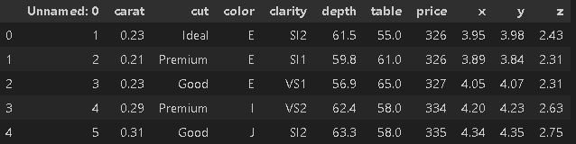
Dataset Overview
Dataset Source: [Diamonds dataset from Kaggle]
Numerical: carat, x, y, z (dimensions)
Categorical: cut (e.g., Ideal, Premium), color, clarity
Target: price in USD
Total Records: 53,940 Goal: Predict price based on diamond features

Slide 6
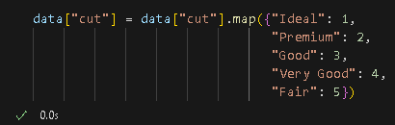

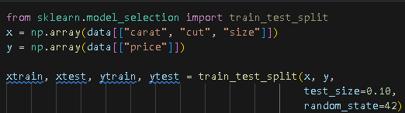

Data Preprocessing
Removed unnecessary columns: unnamed index column
Label Encoding: Converted cut (categorical) to numerical values
Feature Selection: Used only important columns (carat, cut, x, y, z)
Train-Test Split: 80% training, 20% testing

Slide 7
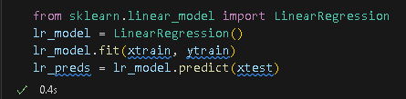
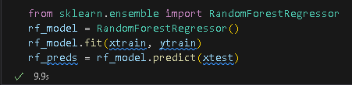
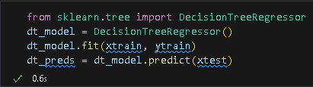
Project Modelling
Models Used
Linear Regression baseline model for predicting price
Decision Tree Regressor captures non-linear patterns
Random Forest Regressor ensemble method for better accuracy

Slide 8
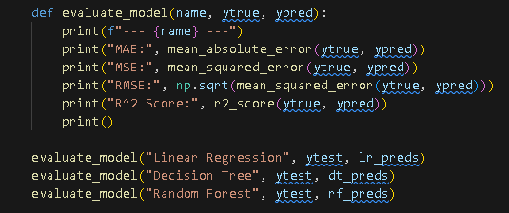
Model Evaluation
Model | MAE | MSE | RMSE | R² Score
Linear Regression | 1006.48 | 2,402,136.51 | 1549.88 | 0.8512
Decision Tree | 905.37 | 3,123,674.04 | 1767.39 | 0.8065
Random Forest | 790.86 | 2,015,884.75 | 1419.82 | 0.8751

Slide 9
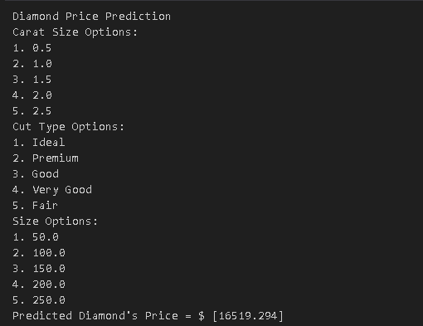
OUTPUT
User Inputs
Carat Size: Shows 5 predefined options user selects one This becomes a
Cut Type Shows a dictionary of cut types mapped to numbers user selects by number .This becomes b.
Size Shows 5 general size values user selects one. This becomes c.
Feature Vector Creation The selected values for carat, cut, and size are combined into a single feature array

Slide 10
Key Findings
Random Forest performed best overall, with the lowest MAE, MSE, RMSE, and highest R² Score (0.875).
Linear Regression had decent performance, but struggled with capturing non-linear relationships.
Decision Tree showed moderate performance but was less consistent than Random Forest.
Price prediction is most influenced by carat and dimensional features (x, y, z).
Model performance suggests that ensemble methods are more robust for this regression task.

Slide 11
CONCLUSION
Evaluations
Automation
Machine learning can predict diamond prices with reasonable accuracy.
This approach can help automate diamond valuation, supporting businesses and customers in decision-making.
Essencials
Best Algo
Feature selection and encoding were essential to model success.
Random Forest provided the most reliable predictions, making it suitable for real-world use.

Slide 12
Step-by-step coding
01
02
03
04
Dataset Exploring
Data preprocessing
evaluation
Model Training & testing

Slide 13
Classification

Slide 14
Project Introduction
Title: Credit Card Fraud Detection Using Classification Models Objective: This project focuses on detecting fraudulent transactions from credit card data using machine learning models. We compare traditional models like Logistic Regression with more advanced approaches like Artificial Neural Networks (ANN) to improve classification accuracy on imbalanced datasets.

Slide 15
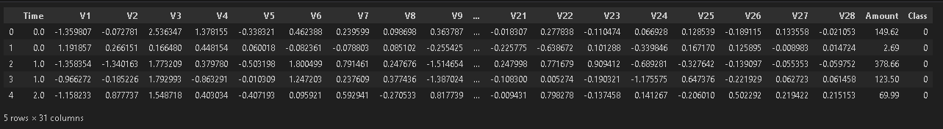
Dataset Overview
Dataset Name : creditcard.csv Source: Kaggle (standard fraud detection dataset) Overview:
Features: 30 (V1–V28 anonymized, plus Time & Amount)
Target: Class (0 = Legit, 1 = Fraud)
Size: 284,807 transactions, only 492 are fraud (highly imbalanced)

Slide 16



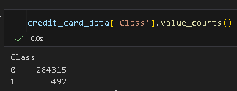

Data Preprocessing
Checked for missing values (none found)
Analyzed class imbalance (492 fraud, 284,315 legit) very unbalanced
Applied under sampling on legit transactions to match fraud count
Separated dataset into features (X) and target (Y)
Split data using train-test split with stratification

Slide 17

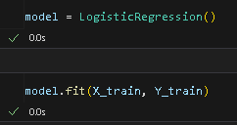

Modeling
1. Logistic Regression:
A simple baseline classifier
Fast, interpretable, and good for linear decision boundaries
2. Artificial Neural Network (ANN):
2 Hidden Layers: Dense(16, ReLU) → Dense(8, ReLU) → Output(Sigmoid)
Trained with Adam optimizer & binary cross-entropy loss
Epochs: 20 | Batch size: 32

Slide 18
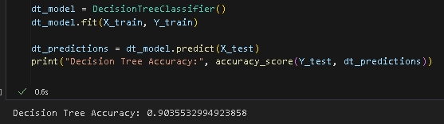


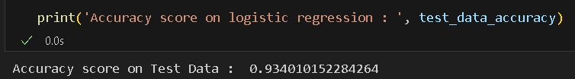
Evaluation
Model | Accuracy Score
Logistic Regression | 93.40%
ANN | 93.91%
Decision Tree | 90.35%

Slide 19
Key findings
Under sampling effectively balanced the dataset
ANN significantly improved accuracy over logistic regression
Fraudulent transactions, though rare, show detectable patterns
ANN model generalizes well without overfitting in 20 epochs

Slide 20
CONCLUSION
Evaluations
Merits
Successfully developed fraud detection models using both traditional and deep learning methods
These results highlight the importance of deep learning in sensitive, high-risk domains like fraud detection.
Essencials
Best Algo
Preprocessing, especially balancing and scaling, was crucial
ANN achieved the best performance with 93.9% accuracy

Slide 21
Jazakallah

